Slide 1

TRANSPOSITION CIPHER
In the transposition technique the positions of letters/numbers/symbols in plain text is changed with one another.
1 | 2 | 3 | 4 | 5 | 6
M | E | E | T | M | E
A | F | T | E | R | P
A | R | T | Y
4 | 2 | 1 | 6 | 3 | 5
T | E | M | E | E | M
E | F | A | P | T | R
Y | R | A |  | T

Slide 2
TRANSPOSITION CIPHER TECHNIQUES
Rail Fence Cipher
Columnar Transposition
  Simple Columnar Transposition
  Double Columnar Transposition

Slide 3
1. RAIL FENCE CIPHER
In this method plain text is written downwards on “rails of fence “ , starting a new column when bottom is reached.
Algorithm:
First write down plain text message as a sequence of diagonals.
Read the plain text written in first step as a sequence of rows.

Slide 4
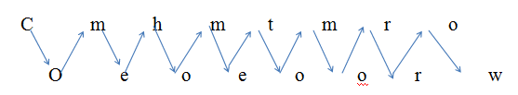
1. RAIL FENCE CIPHER
Example:
Plain text: come home tomorrow
Cipher text: cmhmtmrooeoeoorw

Slide 5
1. Simple Columnar Transposition
In this method the message is written in rows of fixed length and then read out column by column
Column are selected in some in some scrambled order.
The number of columns are defined by the length of key.
Algorithm:
Write the plain text message row by row in a rectangle of predefined size.(length of key)
Read the message column by column according t the selected order thus obtained message is a cipher text.

Slide 6
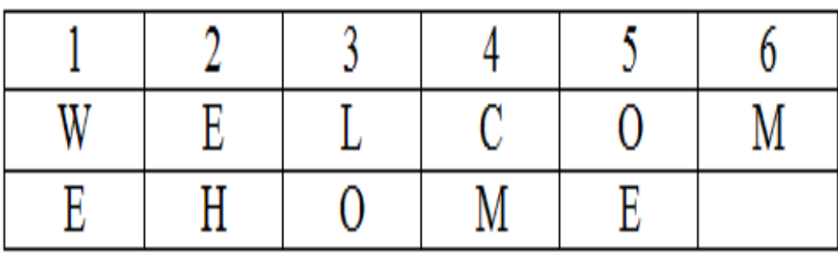
1. SIMPLE COLUMNAR TRANSPOSITION
Key: ZEBRAS
plain text: welcome home
Order : 6 3 2 4 1 5
Cipher text: MLOEHCMWEOE

Slide 7
2.Double Columnar Transposition
Single columnar transposition can be attack by guessing possible column lengths.
Therefore to make it stronger double transposition is used.
This is simple columnar transposition technique applied twice.
Here same key can be used for transposition or two different keys can be used.

Slide 8
2.DOUBLE COLUMNAR TRANSPOSITION
First apply simple columnar transposition
Key: ZEBRAS
plain text: welcome home
Order : 6 3 2 4 1 5
Cipher text: MLOEHCMWEOE

Slide 9

2.DOUBLE COLUMNAR TRANSPOSITION
Cipher text 1: MLOEHCMWEOE
Order : 6 3 2 4 1 5
Final Cipher Text: COELWEOMMHE

Slide 10
Substitution Cipher | Transposition Cipher
A substitution technique is one in which the letters/number/symbols of plain text are replaced by other letters/numbers/symbols. | In the transposition technique the positions of letters/numbers/symbols in plain text is changed with one another.
It is easy to understand. | It is difficult to understand.
Methods: Caesar's Cipher Mono-Alphabetic Cipher A Homophonic Substitution Cipher A Polygram Substitution Cipher A Polyalphabetic Substitution Cipher e.g.Vigenere Cipher One time Pad(Vernam Cipher) | Methods: Rail Fence Cipher Columnar Transposition Simple Columnar Transposition Double Columnar Transposition

